Slide 1
Attack surface reduction
Author: Lorenzo J. Ireland (CSA – Security)
Date: 4 Jan 2023
On a budget; But cloud enabled ☺

Slide 2
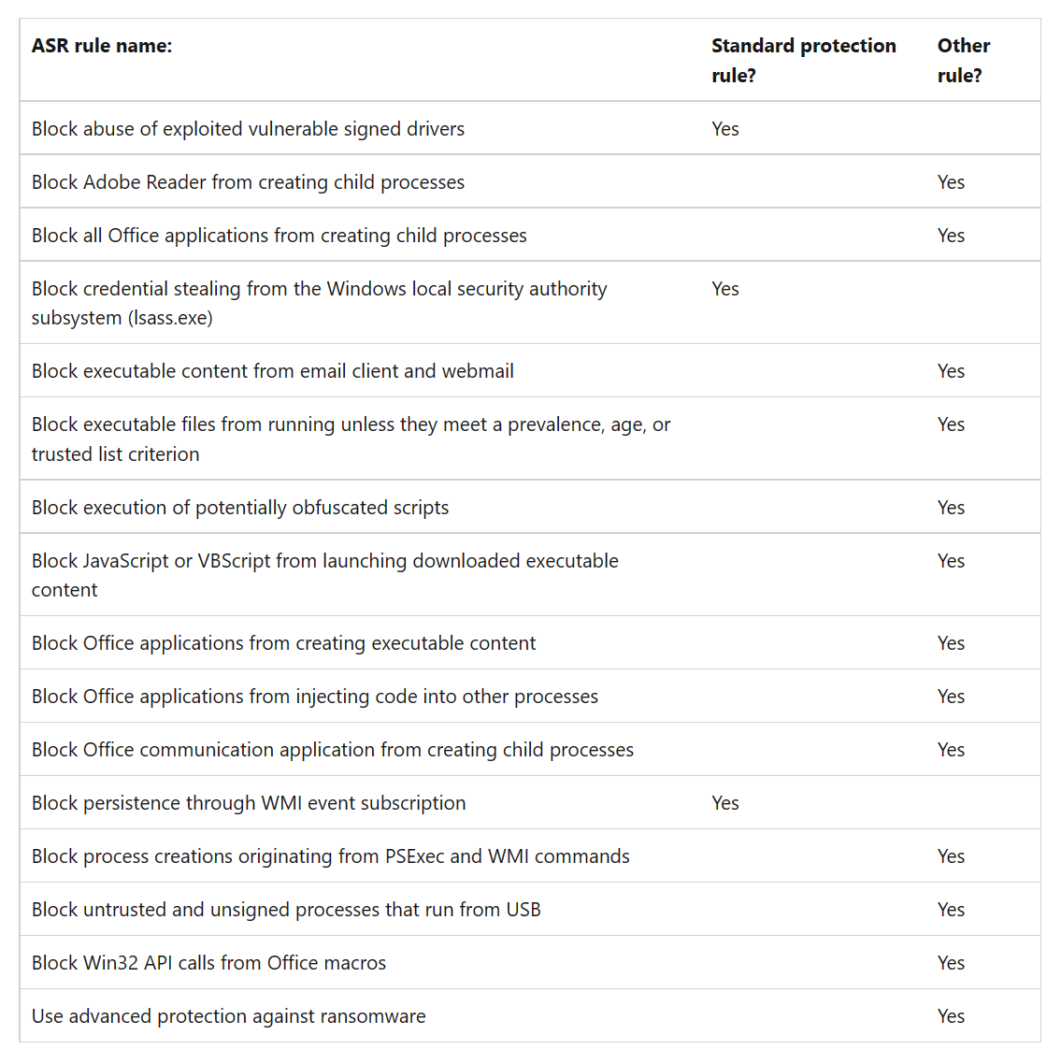
ASR rules Defined
Notes:
4 JAN 2023 | Source: Attack surface reduction rules reference | Microsoft Learn

Slide 3
The Problem ☹
ASR offers great integrated endpoint security, however, it is not enabled by default
Customer has many Windows VM’s in Azure & Azure Arc Azure tenant lacks a config management solution (InTune, GPO, SCCM, AD)
Provide the ability to add/modify ASR Rules & modes [0,1,2,6] against selected endpoints in Azure
Enable ASR in a semi-automated manner and facilitate the ability to target specific Windows VMs that reside in Azure and/or Azure Arc

Slide 4
Let's technology!
PowerShell
Excellent technology that is organic to all Windows VM’s
Is used throughout the Azure ecosystem
Azure
Exceptional cloud platform that is very well integrated running Windows VM’s be they native to Azure or on premise and connected via Azure Arc (Hybrid)
Robust API’s, CLI, and PowerShell Az Modules facilitate solving a wide range of problems that was harder to accomplish when information systems lacked cloud integration.

Slide 5
A Solution ☺
Offer switches to be applied to CmdLet (e.g. –AllVms –CheckAzModules)
Provide user the opportunity to log into their Azure subscription
Install missing Az modules to support functionality
Az.Accounts
Az.Compute
Az.GetConnectedMachine
Provide flexibility for all or selected ASR rules to be applied
Provide flexibility to specify a Resource Group
Provide flexibility to change ASR rule modes [0,1,2,6]
Provide flexibility to apply ASR rules against one or more Windows VM’s that reside in either Azure (native) or Azure Arc (hybrid)

Slide 6

!!DEMO TIME!!
Notes:
Demonstration often leads to demolition!

Slide 7
Final Result
ASR rules are applied with selected mode against selected endpoints.
If specified, ASR rules are validated before processing.
Resource Group must be specified and exist in current subscription.
Windows VM’s must be running and be a part of Azure | Azure Arc, tied to the specified Resource Group.
GitHub Repo: https://github.com/dcodev1702/azure_asr_rules

Slide 8
SHORTFALLS
PowerShell script has not been thoroughly tested; this is intended for small Azure environments on non-production workloads.
ASR Rules are statically defined, requires maintenance.
One could maintain a asr_riles file on Github and modify script to read from that file for ASR definitions.
PowerShell script lacks proper exception handling.
PowerShell script lacks proper formatting, this will be addressed.
Currently limited to one subscription, this should be easy to address.

